Slide 1
Text Recognition From Canned Cat/Dog Food
Xinyue Wang, Zhiyi Ren
Notes:
Good morning Guys and Michael, Today we are going to present our final results about Text Detection and Recognition tech for the Canned cat/dog food.

Slide 2
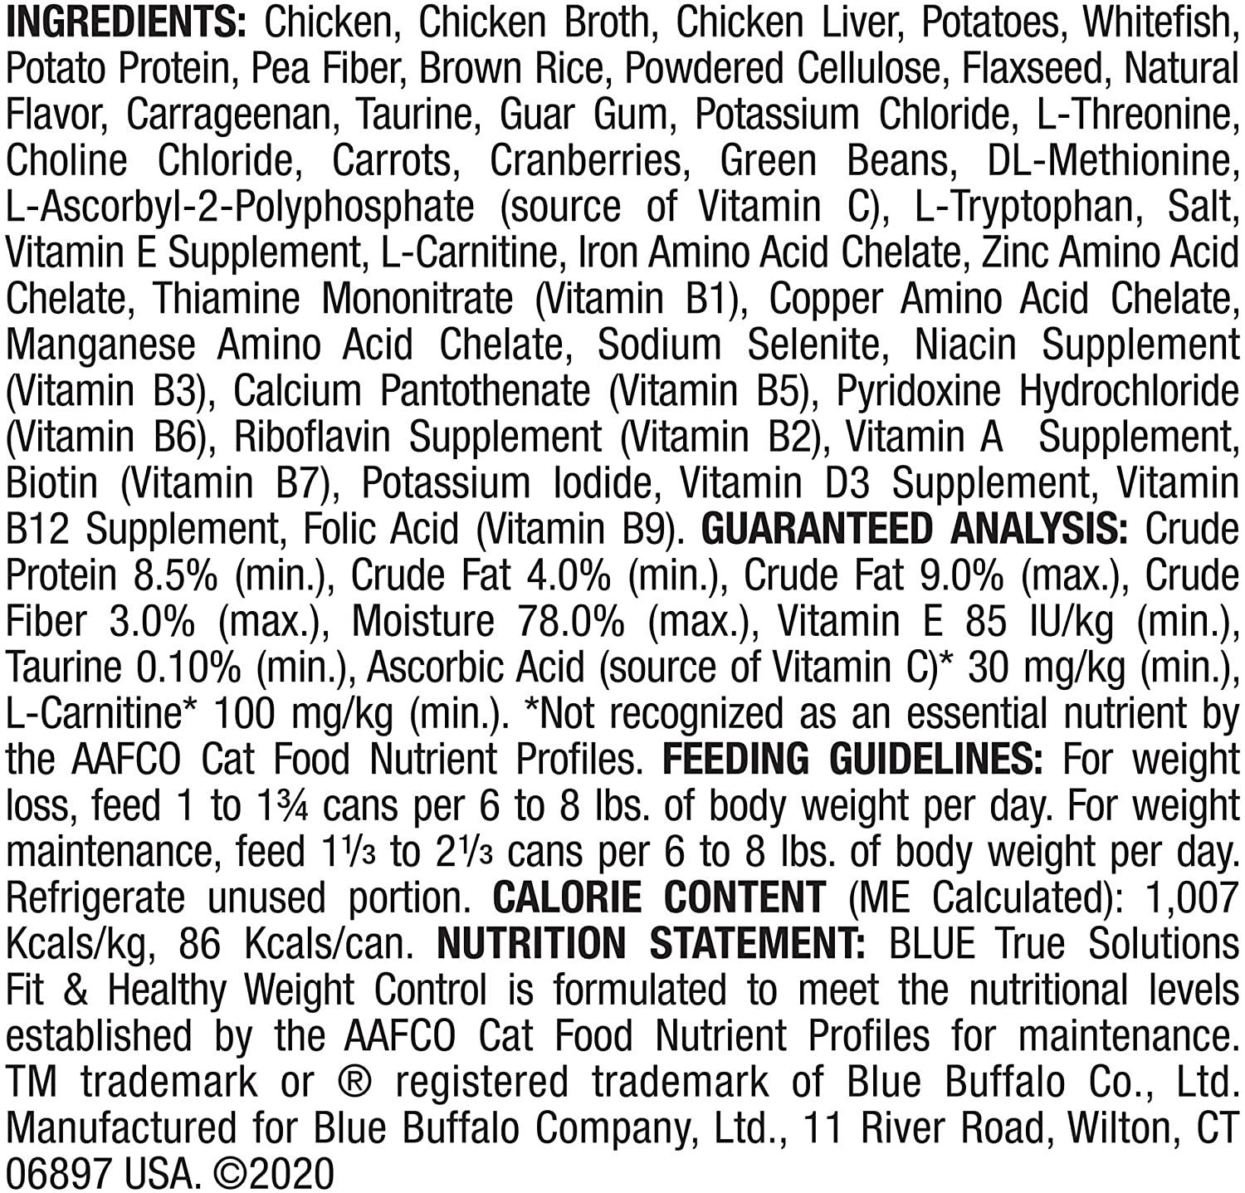


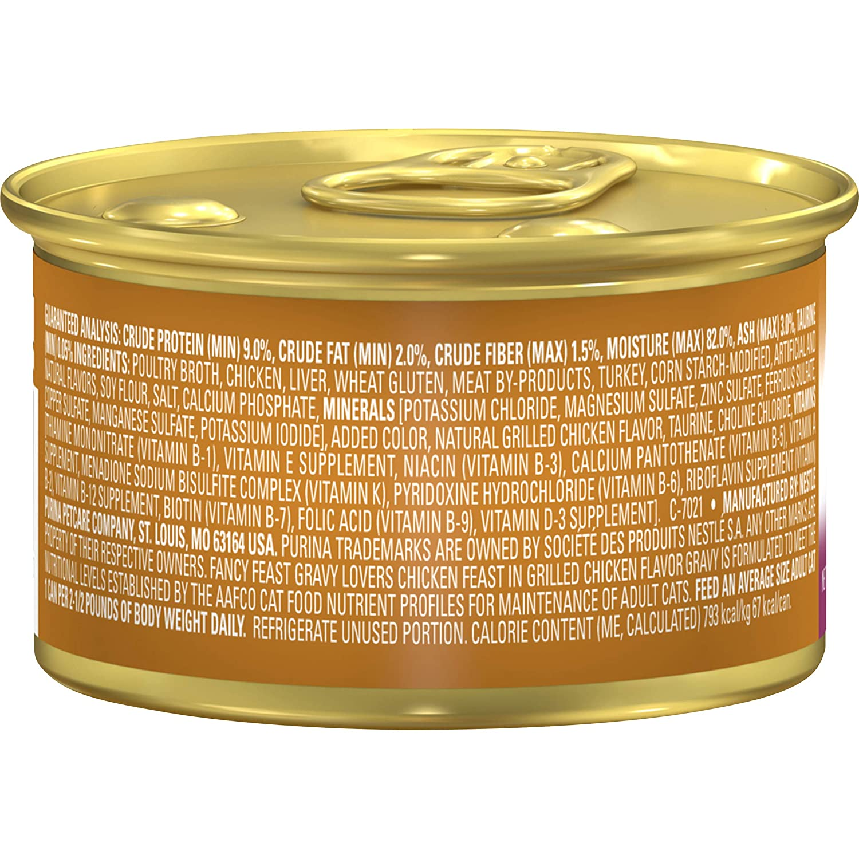
Goal
Our pets
Text is tiny and small
Extract useful information from Canned Food by
use text recognition algorithms and string pattern
Grey
BenBen
Notes:
Sparked by our daily life, Xinyue and I are pets lovers. As a responsible pet owner, when picking the canned food for pets, we care about the nutrition/ingredients. However, the thing is that The pet food can is very small, and the Ingredients list on the can is tiny. It’s hard or time consuming for pet owners to recognize the important main ingredients. So our goal is to extract useful information from Canned Food that will help the pets owers to quickly target the key info.

Slide 3
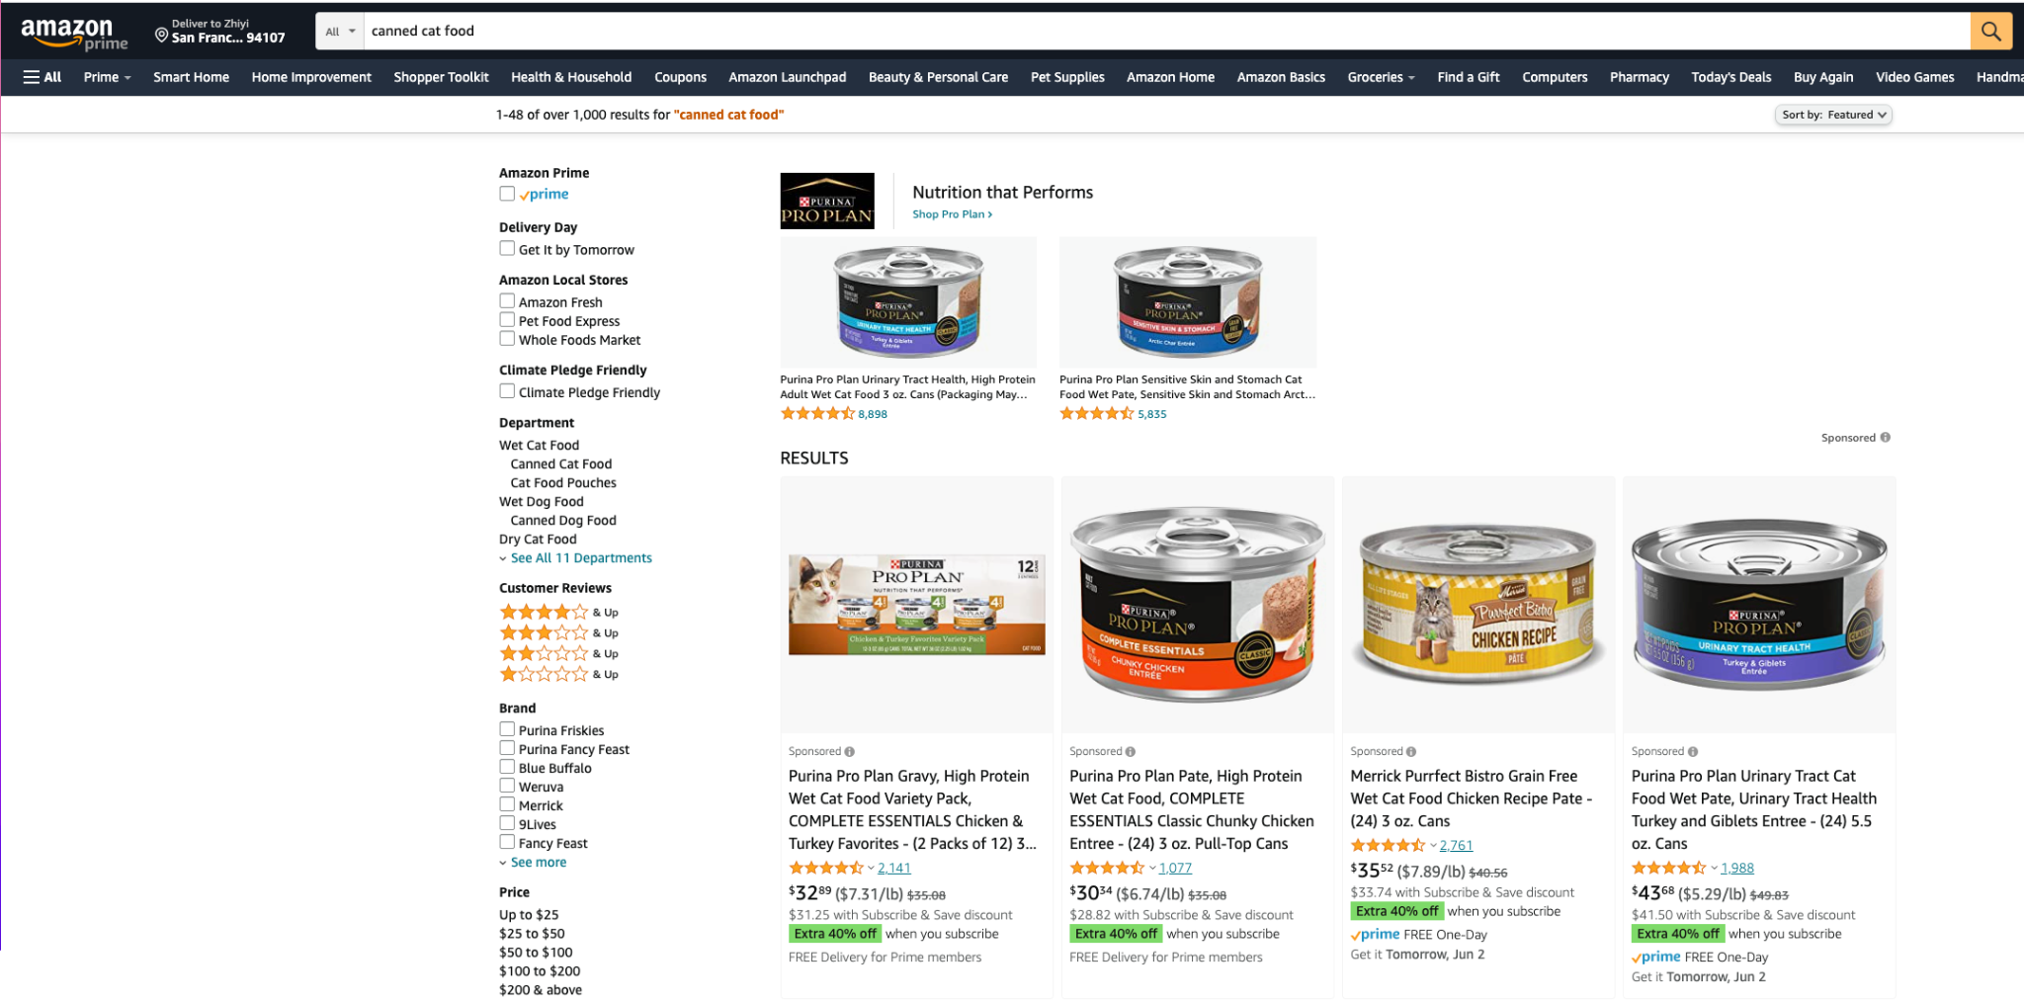
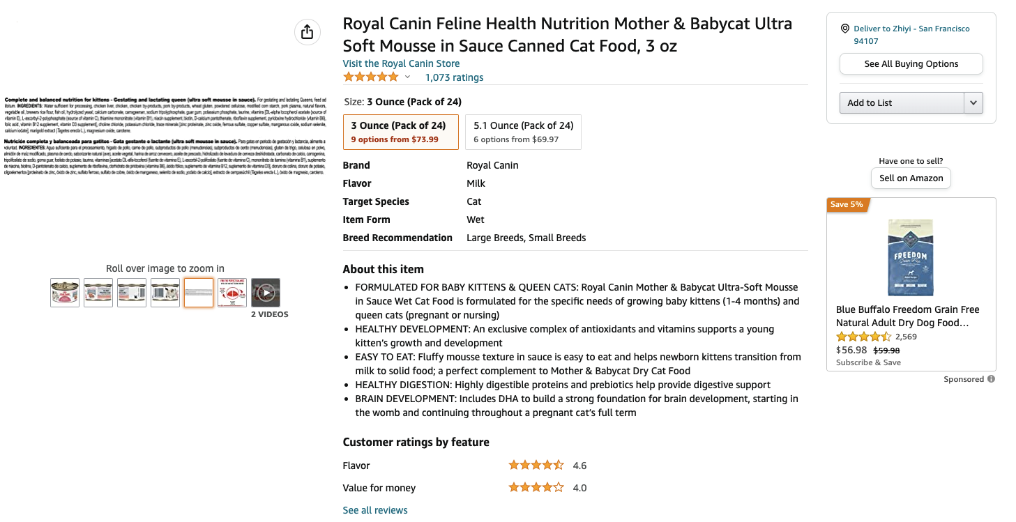
Data
Online Shops
77 images of the canned pet food
Notes:
As there are no prepared data set for pet food label images, we manually grab the data from online web-pages and collect 77 canned food ingredient pics for dog and cat canned food as our feed data.

Slide 4
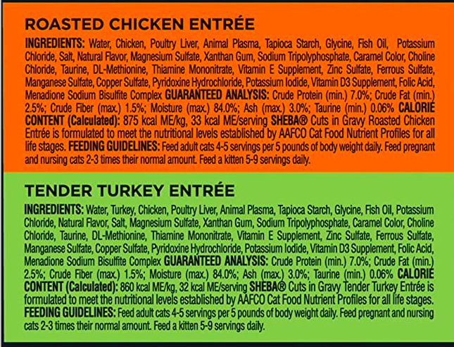
Pipeline
Text Recognition
NLP Process
Important Nutrition & Ingredients
Label Image
Words
Chicken: Chicken Broth, Chicken, Liver, Meat By-Products, Fish, Artificial And Natural Flavors, Pork Plasma, Steamed Bone Meal, Sodium Tripolyphosphate, Locust Bean Gum, Minerals [Potassium Chloride, Magnesium Sulfate, Zinc Sulfate, Iron Sulfate, Manganese Sulfate, Copper Sulfate, Calcium Iodate], Guar Gum, Taurine, L-Ascorbic Acid, Choline Chloride, Salt, Vitamins [Vitamin E Supplement, Niacin (Vitamin B-3), Thiamine Mononitrate (Vitamin B-1), Calcium Pantothenate (Vitamin B-5), Riboflavin Supplement (Vitamin B-2), Pyridoxine Hydrochloride (Vitamin B-6), Biotin (Vitamin B-7), Vitamin A Supplement, Vitamin B-12 Supplement, Folic Acid (Vitamin B-9), Vitamin D-3 Supplement, Menadione Sodium Bisulfite Complex (Vitamin K)]. A654318; Salmon: Poultry Broth, Poultry, Liver, Meat By-Products, Salmon, Artificial And Natural Flavors, Pork Plasma, Steamed Bone Meal, Sodium Tripolyphosphate, Locust Bean Gum, Minerals [Potassium Chloride, Magnesium Sulfate, Zinc Sulfate, Iron Sulfate, Manganese Sulfate, Copper Sulfate, Calcium Iodate], Guar Gum, Taurine, L-Ascorbic Acid, Choline Chloride, Vitamins [Vitamin E Supplement, Niacin (Vitamin B-3), Thiamine Mononitrate (Vitamin B-1), Calcium Pantothenate (Vitamin B-5), Riboflavin Supplement (Vitamin B-2), Pyridoxine Hydrochloride (Vitamin B-6), Biotin (Vitamin B-7), Vitamin A Supplement, Vitamin B-12 Supplement, Folic Acid (Vitamin B-9), Vitamin D-3 Supplement, Menadione Sodium Bisulfite Complex (Vitamin K)]. A654218; Tuna: Chicken Broth, Chicken, Liver, Meat By-Products, Tuna, Artificial And Natural Flavors, Pork Plasma, Sodium Tripolyphosphate, Steamed Bone Meal, Locust Bean Gum, Minerals [Potassium Chloride, Magnesium Sulfate, Zinc Sulfate, Iron Sulfate, Manganese Sulfate, Copper Sulfate, Calcium Iodate], Guar Gum, Taurine, L-Ascorbic Acid, Choline Chloride, Vitamins [Vitamin E Supplement, Niacin (Vitamin B-3), Thiamine Mononitrate (Vitamin B-1), Calcium Pantothenate (Vitamin B-5), Riboflavin Supplement (Vitamin B-2), Pyridoxine Hydrochloride (Vitamin B-6), Biotin (Vitamin B-7), Vitamin A Supplement, Vitamin B-12 Supplement, Folic Acid (Vitamin B-9), Vitamin D-3 Supplement, Menadione Sodium Bisulfite Complex (Vitamin K)]. A654118; Beef: Chicken Broth, Chicken, Meat By-Products, Liver, Salmon, Artificial And Natural Flavors, Beef, Pork Plasma, Steamed Bone Meal, Sodium Tripolyphosphate, Locust Bean Gum, Minerals [Potassium Chloride, Magnesium Sulfate, Zinc Sulfate, Iron Sulfate, Manganese Sulfate, Copper Sulfate, Calcium Iodate], Guar Gum, Taurine, L-Ascorbic Acid, Choline Chloride, Salt, Vitamins [Vitamin E Supplement, Niacin (Vitamin B-3), Thiamine Mononitrate (Vitamin B-1), Calcium Pantothenate (Vitamin B-5), Riboflavin Supplement (Vitamin B-2), Pyridoxine Hydrochloride (Vitamin B-6), Biotin (Vitamin B-7), Vitamin A Supplement, Vitamin B-12 Supplement, Folic Acid (Vitamin B-9), Vitamin D-3 Supplement, Menadione Sodium Bisulfite Complex (Vitamin K)]. A654018
Chicken, Liver, Fish
Crude Protein (min) 11.0%
Crude Fat (min) 1.8%
Crude Fiber (max) 0.5%
Moisture (max) 84.0%
Ash (min) DM 1.5%
Notes:
Take photo - transfer words/ from label - summary table - idea output(nutr fact)

Slide 5
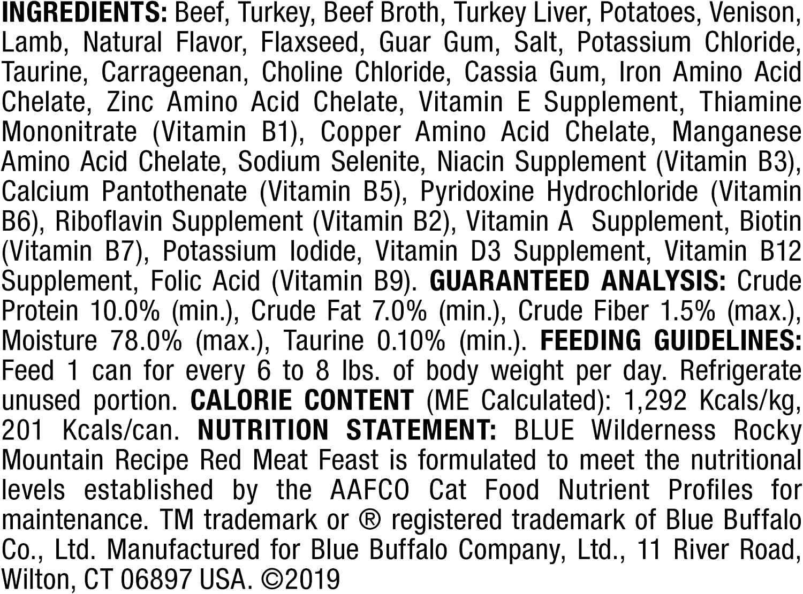
Step 1. Text Recognition
cat33.jpg
INGREDIENTS: Beef, Turkey, Beef Broth, Turkey Liver, Potatoes, Venison,
Lamb, Natural Flavor, Flaxseed, Guar Gum, Salt, Potassium Chloride,
Taurine, Carrageenan, Choline Chloride, Cassia Gum, Iron Amino Acid
Chelate, Zinc Amino Acid Chelate, Vitamin E Supplement, Thiamine
Mononitrate (Vitamin B1), Copper Amino Acid Chelate, Manganese
Amino Acid Chelate, Sodium Selenite, Niacin Supplement (Vitamin B3),
Calcium Pantothenate (Vitamin B5), Pyridoxine Hydrochloride (Vitamin
B6), Riboflavin Supplement (Vitamin B2), Vitamin A Supplement, Biotin
(Vitamin B7), Potassium lodide, Vitamin D3 Supplement, Vitamin B12
Supplement, Folic Acid (Vitamin B9). GUARANTEED ANALYSIS: Crude
Protein 10.0% (min.), Crude Fat 7.0% (min.), Crude Fiber 1.5% (max.),
Moisture 78.0% (max.), Taurine 0.10% (min.). FEEDING GUIDELINES:
Feed 1 can for every 6 to 8 lbs. of body weight per day. Refrigerate
unused portion. CALORIE CONTENT (ME Calculated): 1,292 Kcals/kg,
201 Kcals/can. NUTRITION STATEMENT: BLUE Wilderness Rocky
Mountain Recipe Red Meat Feast is formulated to meet the nutritional
levels established by the AAFCO Cat Food Nutrient Profiles for
maintenance. TM trademark or ® registered trademark of Blue Buffalo
Co., Ltd. Manufactured for Blue Buffalo Company, Ltd., 11 River Road,
Wilton, CT 06897 USA. ©2019
tesseract
Notes:
label image cat33 as an example - illustrate what we did

Slide 6
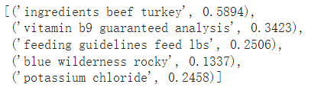
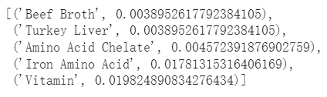
Step 2. Keyword Extraction
KeyBERT
Yake
kw_model.extract_keywords(content, keyphrase_ngram_range=(1, 4), use_mmr=True, diversity=0.7, top_n=5)
yake.KeywordExtractor(dedupLim= 0.5,top= 5)
Notes:
Try - 2 models KeyBert& Yake - top5 - hyper - dup - main ing

Slide 7
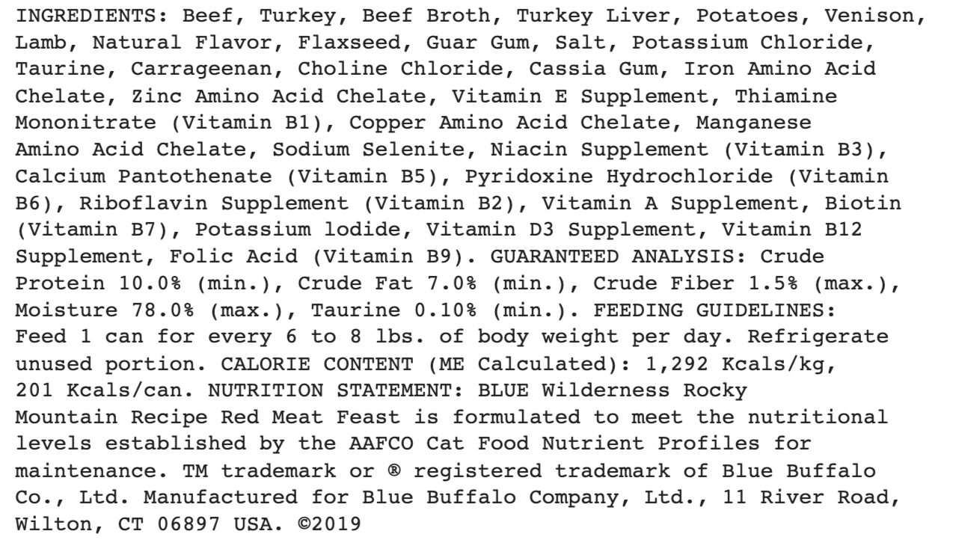
Step 3. String Pattern Matching
cat33.jpg
After Extraction Result
Notes:
Although we grabbed words from images, we think the guaranteed analysis also reflect the important info that pets owners care about. But there are many special characters such as the % and () that we are unable to extract this part using existing keyword extraction model. Therefore, we identify the particular string patterns to obtain the guaranteed analysis of nutrition content.

Slide 8
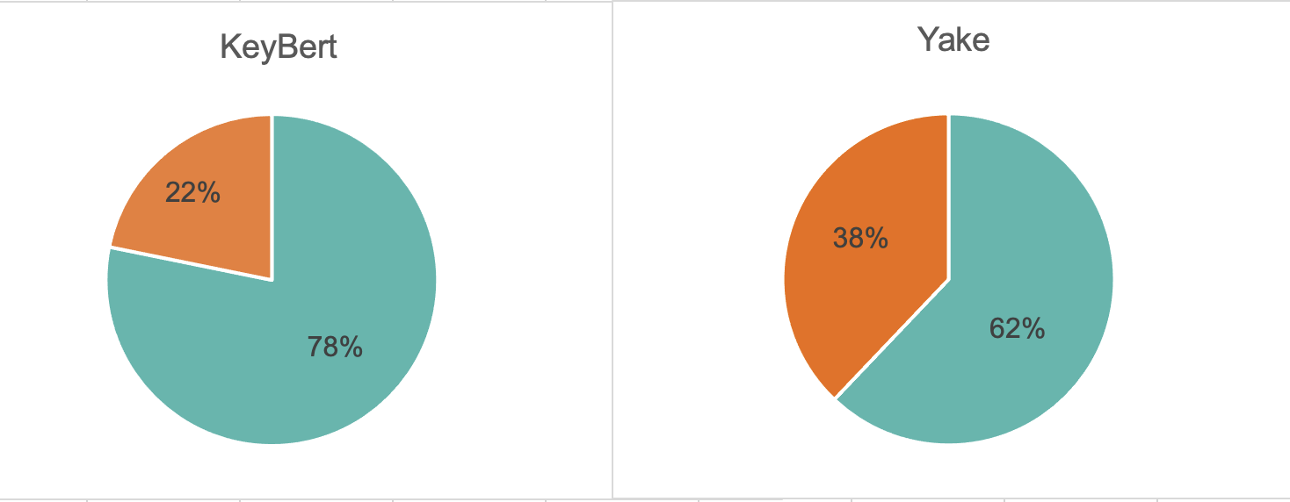
Evaluation
Not useful info
Not useful info
Not useful info
Not useful info
Useful info
Useful info
Notes:
That’s all the process we did. Here is how we evaluate the results. For the word extraction results, we hand label whether it’s a useful info or not. The chart below shows the overall performance of the 2 models. KeyBERT performances better with 78% of useful info.

Slide 9
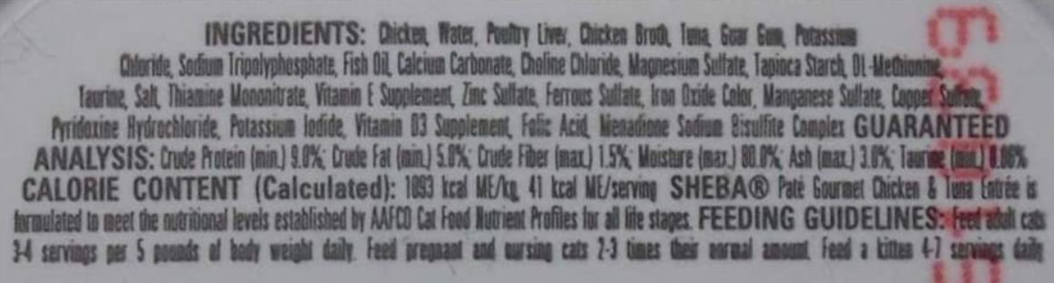
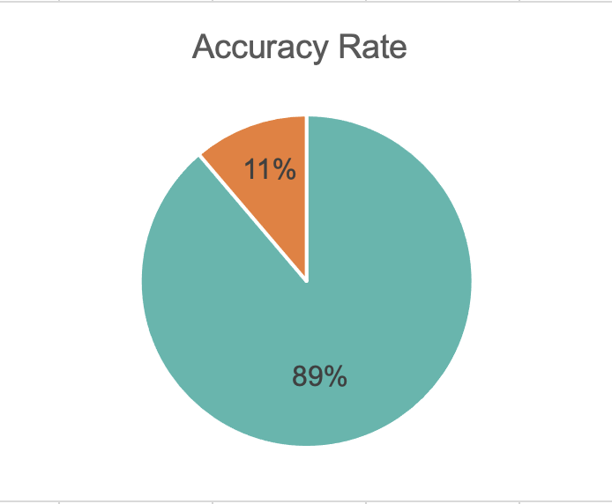
Limitations
cat12.jpg
OCR Results
Information Coverage
Notes:
Beside all thing we did well as discussed above, our project also has some limitations. One is the OCR results. The Tesseract sometimes failed to grab the words. For example, Tesseract returns an empty text file for the label image cat12 showed on the right. We count accuracy rate of the OCR results. It’s about 90%. So for the future work, we may need to try new OCR model or train our own model to improve that.
Another limitation is info coverage. In evaluation part, I only talk about the proportion of useful info, because that it is hard to extract all of the info. If one label has beef, turkey and liver. We may only extract beef and turkey, and lost the word liver. To improve that, we need more customized word extraction model to be train in the future.

Slide 10
Thank You !
Notes:
Project Description Presentation

